Slide 1
GITHUB – CREATING ACCOUNT & ACCEPTING ASSIGNMENTS

Slide 2
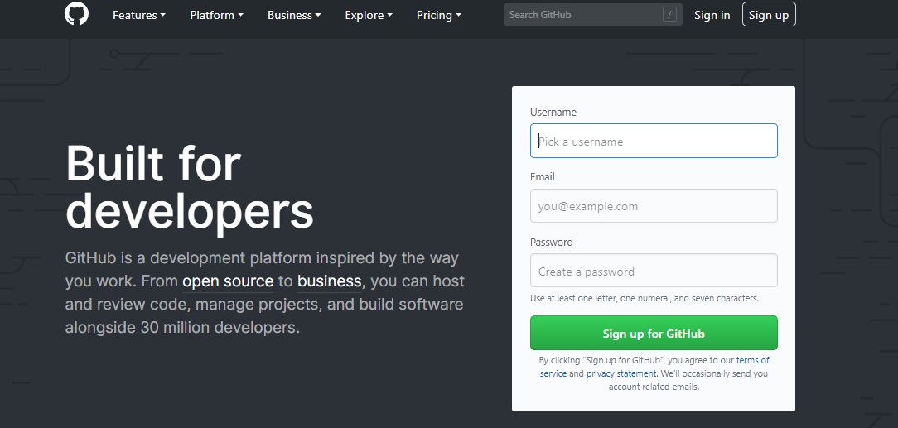
Note:
Search for Github in Google and Click on Sign up
Please use the same email with which you have registered with us.
If you have already have a Github account, you can press Sign in and skip to slide 7

Slide 3
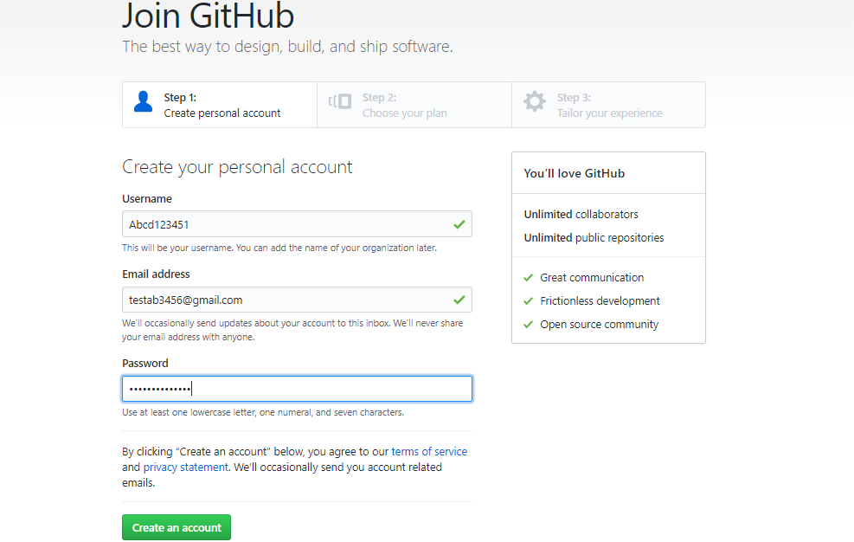
Please keep your Full name as Username. Do not keep nicknames like: K$4nall
Please try to use the email ID with which you have registered with us. It would be easy for us to track

Slide 4
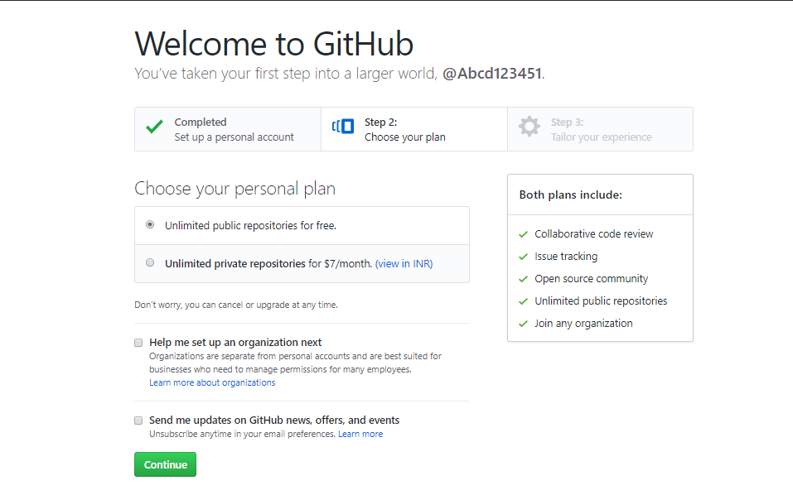

Slide 5
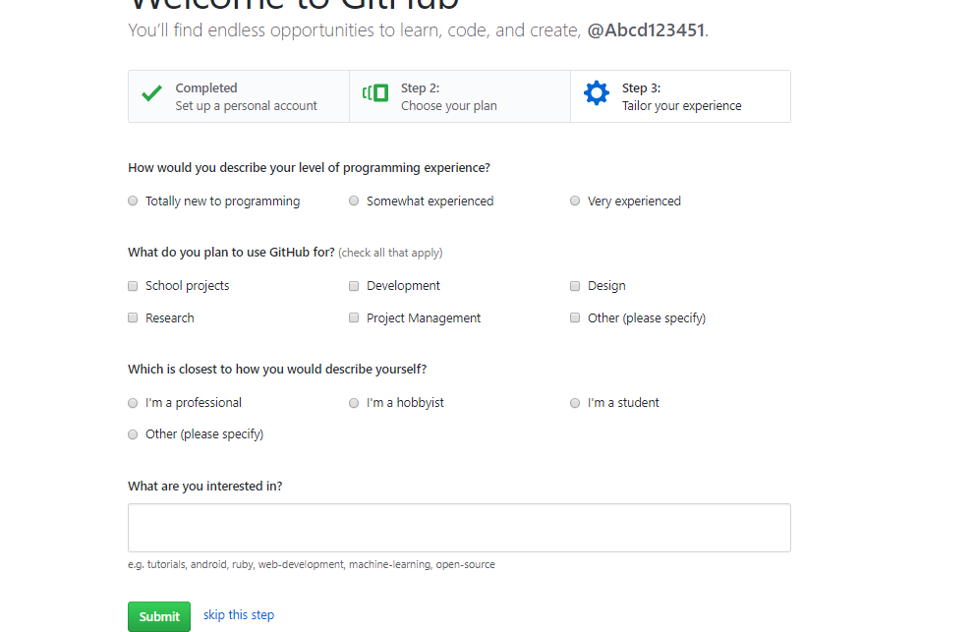
You can click on “Skip this step”

Slide 6
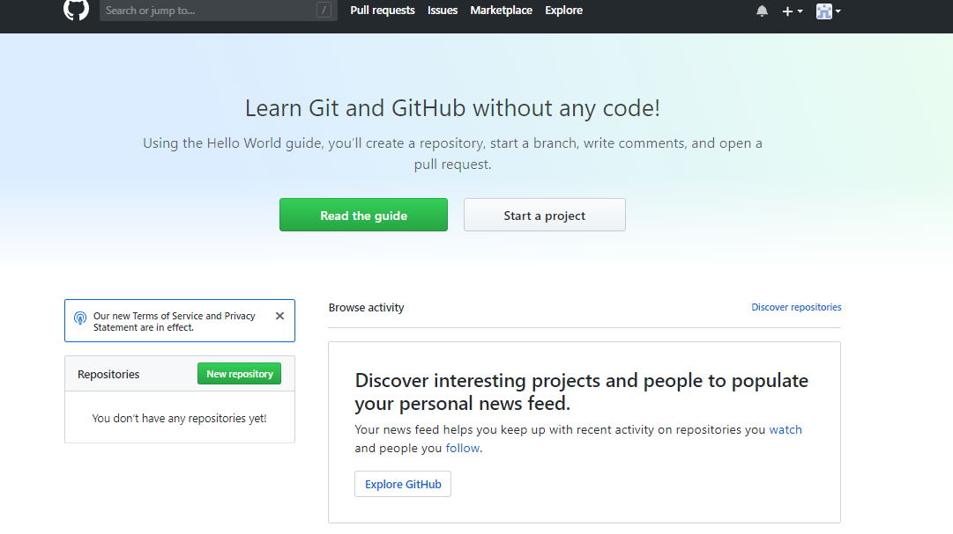
Your Github account is now setup !!

Slide 7
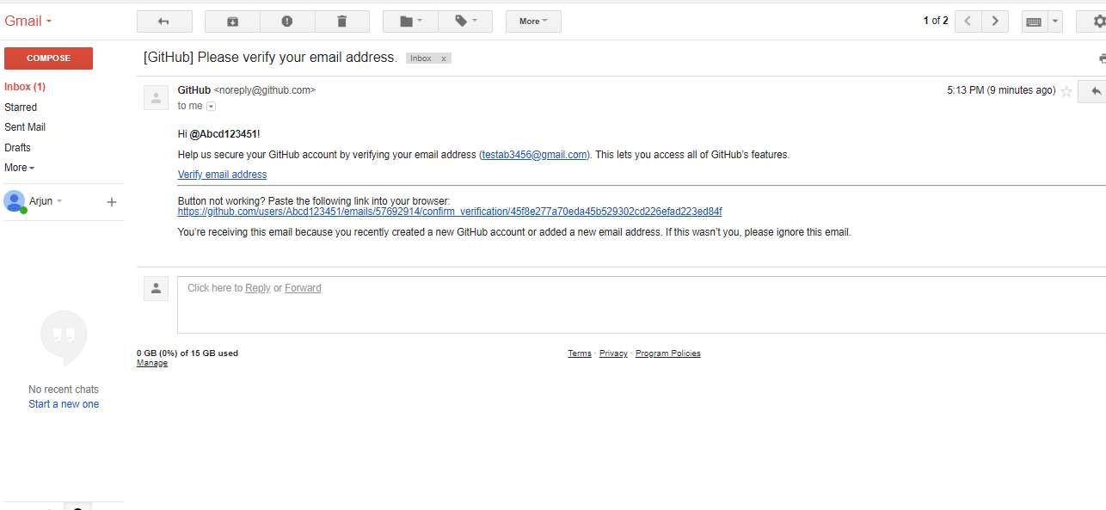
You also should go to your email ID and confirm your email address

Slide 8
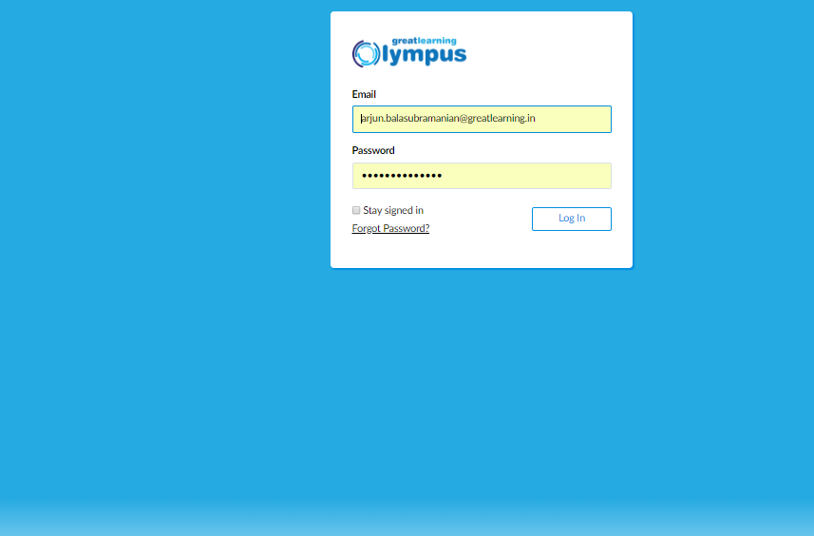
Now Login to your Olympus with your own credentials !!

Slide 9
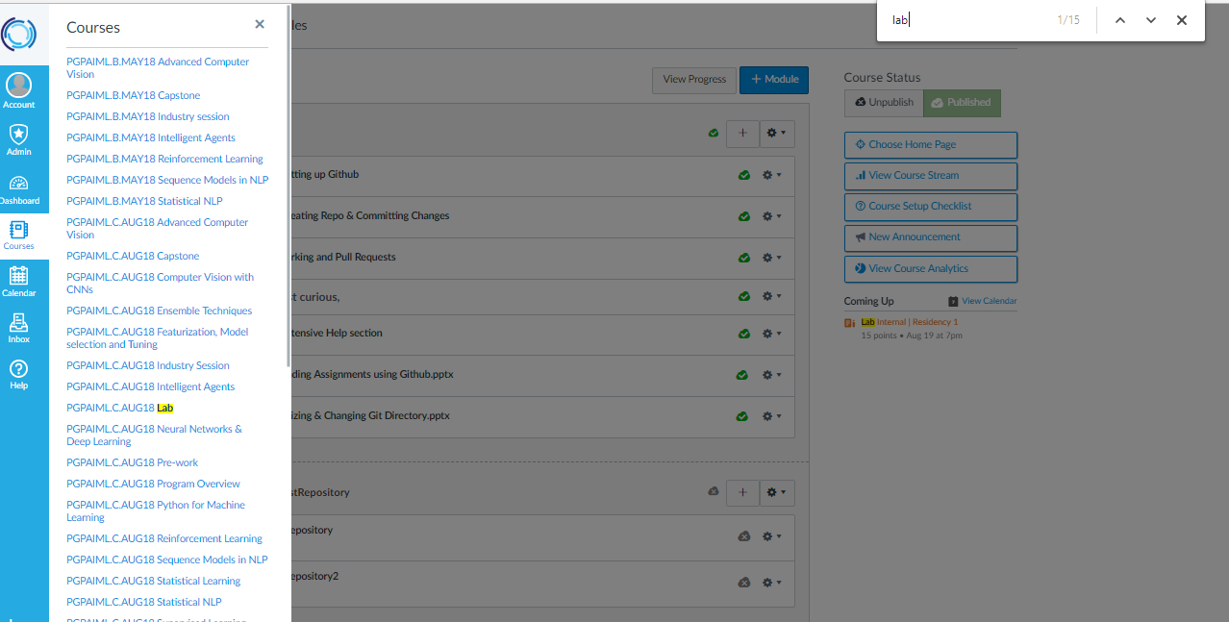
The UI may look different. But the steps are the same !!
Steps:
Go to Courses.
Click on the respective Lab course card – If you are from AIML program go to PGPAIML.C.AUG Lab or if you are from ML program go for PGP.ML.C.AUG Lab respectively

Slide 10
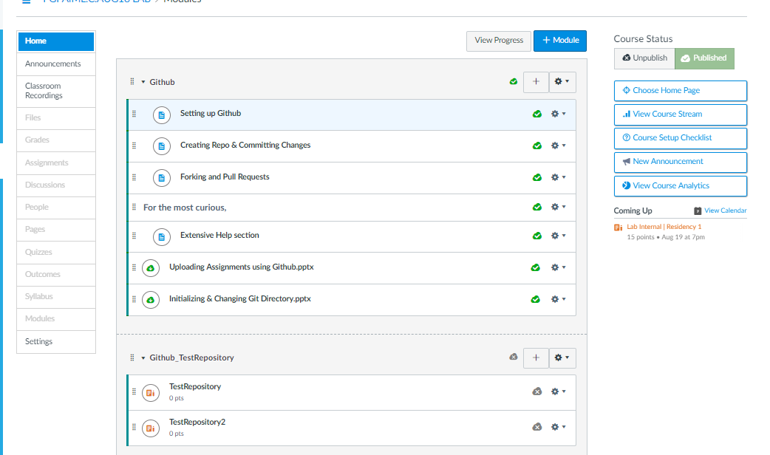
Click on “Test Repository” under Github_TestRepository tab

Slide 11
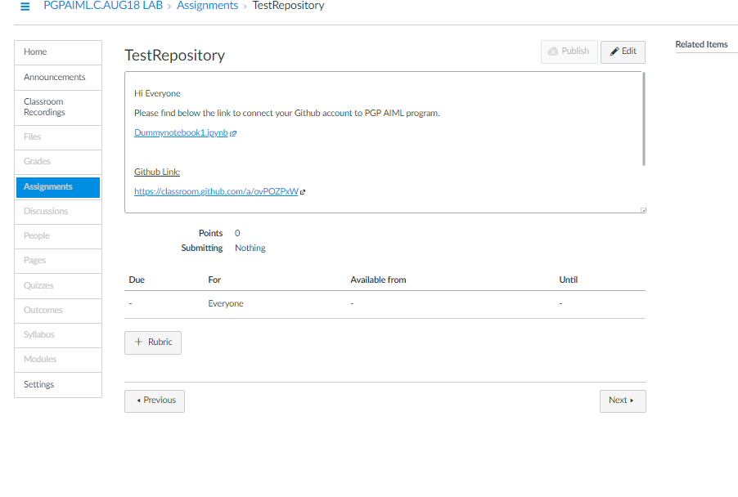
Click on the Github Link

Slide 12
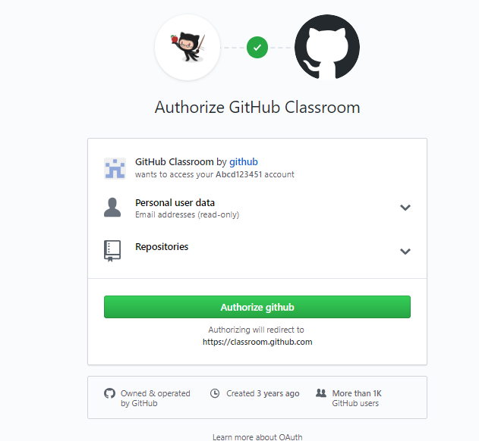
Please Note:
It might ask you for a login into your Github profile if you have logged out.
You just need to enter your Github user name & password.
Post that, you will come back to the screen shown right.
Click on “Authorize github”

Slide 13
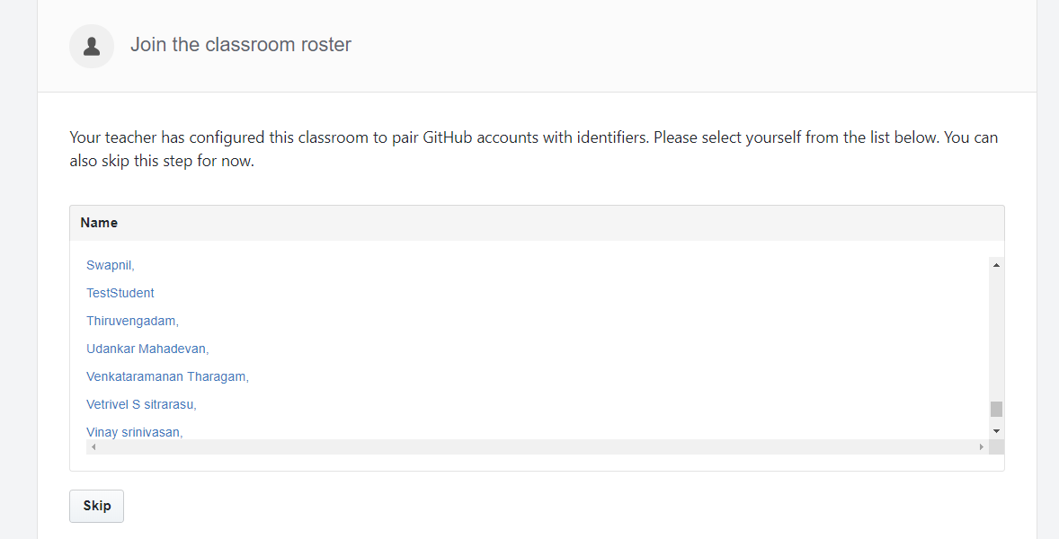
Steps:
1. Click on your name
Please be careful not to select any other name apart from Yours !!!

Slide 14
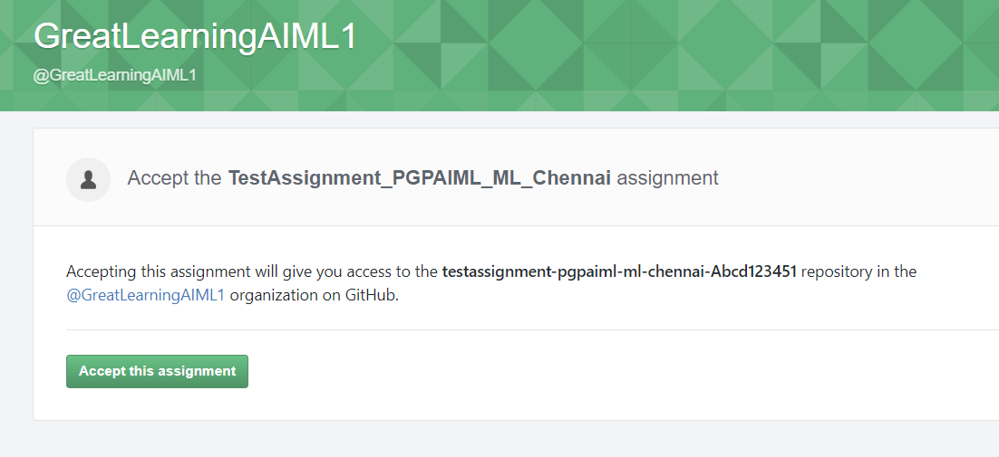

Slide 15
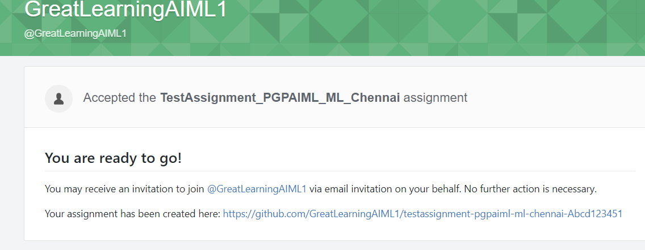
Steps:
Click on this link !
This link automatically creates a “Private repository” in your own Github profile.
Since these repositories are private – No one else can look at these look at your work but for GL gurus & moderators. Hence No Plagiarism !! No copying
At the end of the program, we will make all the repos PUBLIC !!

Slide 16
